Slide 1

ICE4101: Artificial Intelligence Genetic Algorithm
Week 13
Instructor: M. Shamim Kaiser
Email: shamimkaiser@gmail.com
Cell Phone : 01971932323
Skype: shamimkaiser

Slide 2
Genetic Algorithm (John Hollond)
Genetic Algorithm (GA) is a search-based optimization technique based on the principles of Genetics and Natural Selection.
It is frequently used to find optimal or near-optimal solutions to difficult problems which otherwise would take a lifetime to solve.
It is frequently used to solve optimization problems, in research, and in machine learning.
Optimization refers to find the values of inputs in such as way that we get the best output values.
The set of all possible values which the inputs can take make up the search space. Optimal solution lies in the search space.

Slide 3
Advantages
Faster and more efficient compared to traditional methods
Optimize both continuous and discrete functions
Provides a list of good solution
Always gets an answer to the problem which gets better over the time
Useful for large search space

Slide 4
Steps
Select Encoding Type
Choose population size
Create initial random population
Evaluate fitness using a fitness function
Is the solution optimal/suboptimal?
If yes, then end
If no, reproduce new population
Replace current chromosome population with new population (Crossover, Mutation)

Slide 5
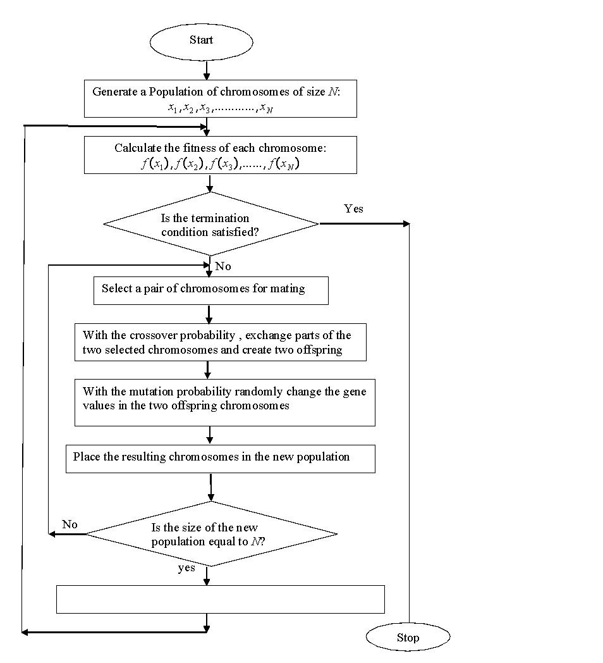

Slide 6
Step 1: Represent the problem variable domain as a chromosome of a fixed length, choose the size of a chromosome population N, the crossover probability p_{c} and the mutation probability p_{m}. Step2: Define a fitness function to measure the performance, or fitness of an individual chromosome in the problem domain. The fitness function establishes the basis for selecting chromosomes that will be mated during reproduction. Step 3: Randomly generate an initial population of chromosomes of size N: X₁,X₂,X₃, ….,X_{n}. Step 4: Calculated the fitness of each individual chromosome: Step 5: Select a pair of chromosomes for mating from the current population. Parent chromosomes are selected with a probability related to their fitness. Highly fit chromosomes have a higher probability of being selected for mating than less fit chromosomes. Step 6: Create a pair of offspring chromosomes by applying the genetic operators – crossover and mutation. Step 7: Place the created offspring chromosomes in the new population. Step 8: Repeat Step 5 until the size of the new chromosome population becomes equal to the size of the initial population, N. Step 9: Replace the initial (parent) chromosome population with the new (offspring) population. Step 10: Go to Step 4, and repeat the process until the termination criterion is satisfied.

Slide 7
Genetic Algorithm
Genetic algorithms belong to a class of stochastic search method based on biological evolution. They represent a highly parallel adaptive search process.
Central to the idea of GA is a population where individuals in the population represent possible solutions. An individual is called chromosome, in analogy with the genetic chromosome.
The chromosome is usually represented by a bit string consisting of 0s and 1s.
New population is generated from old population with three basic genetic operators namely selection/reproduction, cross-over, and mutation.

Slide 8
Genetic Algorithm (Holland)
heuristic method based on ‘ survival of the fittest ’
useful when search space very large or too complex
for analytic treatment
in each iteration (generation) possible solutions or
individuals represented as strings of numbers
3021 3058 3240
00010101 00111010 11110000
00010001 00111011 10100101
00100100 10111001 01111000
11000101 01011000 01101010

Slide 9
GA ……..
A GA represents an iterative process. Each iteration is called a generation. A typical number of generations for a simple GA can range from 50 to over 500. The entire set of generations is called a run. At the end of a run, we expect to find one or more highly fit chromosomes.
all individuals in population
evaluated by fitness function
individuals allowed to
reproduce (selection),
crossover, mutate

Slide 10
Roulette Wheel Selection
In roulette wheel selection, each chromosome is given a slice of a circular roulette wheel. The area of the slice within the wheel is equal to the chromosome fitness ratio.
To select a chromosome for mating, a random number is generated in the interval [0,1]. It is like spinning a roulette wheel where each chromosome has a segment on the wheel proportional to its fitness.The roulette wheel is spun, and when the arrow comes to the rest on one of the segments, the corresponding chromosome is selected.

Slide 11
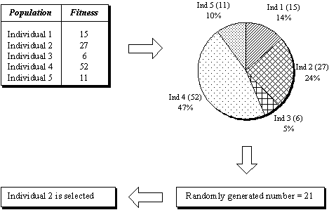
Roulette Wheel Selection

Slide 12
How Cross-over Works?
Cross over: First the crossover operator randomly chooses a crossover point where two parent chromosomes ‘break’ and then exchanges the chromosome parts after that point.
If a pair of chromosomes does not cross-over, then the chromosome cloning takes place and the offspring are created as exact copies of each parent.
A value of 0.7 for the cross-over probability generally produces good results.

Slide 13
Initial Strings
Offspring
Single-Point
11000101 01011000 01101010
11000101 01011001 01111000
00100100 10111001 01111000
00100100 10111000 01101010
Two-Point
11000101 01011000 01101010
11000101 01111001 01101010
00100100 10111001 01111000
00100100 10011000 01111000
Uniform
11000101 01011000 01101010
01000101 01111000 01111010
00100100 10111001 01111000
10100100 10011001 01101000

Slide 14
101100 101111
111111 111100

Slide 15
Mutation
Mutation, which is rare in nature represents a change in the gene. It may lead to a significant improvement in fitness, but more often has rather harmful results.
The mutation operator flips a randomly selected gene in a chromosome.
Mutation can occur at any gene in a chromosome with some probability. The mutation probability is quite small in nature, in the range 0.0001 and 0.01.

Slide 16
Why use Mutation?
Its role is to provide a guarantee that the search algorithm is not trapped on a local optimum. The sequence of selection and crossover operations may stagnate at any homogeneous set of solutions. Under such conditions, all chromosomes are identical, and thus the average fitness of the population cannot be improved. The search algorithm is not able to proceed further. Mutation aids us in avoiding loss of genetic diversity.

Slide 17
Simple Example
f(x) = {MAX(x²): 0 <= x <= 32 }
Encode Solution: Just use 5 bits (1 or 0).
Generate initial population.
Evaluate each solution against objective.
A | 0 | 1 | 1 | 0 | 1
B | 1 | 1 | 0 | 0 | 0
C | 0 | 1 | 0 | 0 | 0
D | 1 | 0 | 0 | 1 | 1
1170
Sol. | String | Fitness | % of Total
A | 01101 | 169 | 14.4
B | 11000 | 576 | 49.2
C | 01000 | 64 | 5.5
D | 10011 | 361 | 30.9

Slide 19
Simple Example (cont.)
Create next generation of solutions
Probability of “being a parent” depends on the fitness.
Ways for parents to create next generation
Reproduction
Use a string again unmodified.
Crossover
Cut and paste portions of one string to another.
Mutation
Randomly flip a bit.
COMBINATION of all of the above.

Slide 20
Application of GA
The Gas have been employed in a wide variety of problems related to pattern recognition and image processing, medical image registration, image segmentation, contour recognition and so on.

Slide 21
Steps
Initial Population (Encoding)
Fitness Assignment
Selection
Crossover
Mutation
Survivor Selection
Terminate if the condition fulfilled

Slide 22
Problem
Knapsack problem by Genetic Algorithm: the prob is that which item should be kept in the knapsack so as it will maximizes knapsack value without breaking it.
Item | Weight (Kg) | Value (Tk)
A | 5 | 12
B | 3 | 5
C | 7 | 10
D | 2 | 7
K=12 kg

Slide 23
K=12 kg
Item | Weight (Kg) | Value (Tk)
A | 5 | 12
B | 3 | 5
C | 7 | 10
D | 2 | 7
A | B | C | D
Generation 2
C3
C1
1 | 1 | 0 | 0
C1
0 | 1 | 1 | 0
0 | 1 | 1 | 0
C2
0 | 1 | 0 | 1
1 | 1 | 1 | 0
C3
1 | 1 | 0 | 0
0 | 1 | 0 | 0
 | Weight (Kg) | Value (Tk)
C1 | 10 | 15
C2 | 5 | 12
C3 | 8 | 17
C4 | 17 | 34
C4
1 | 1 | 1 | 1
C3
C2
1 | 1 | 0 | 0
0 | 1 | 0 | 1
Total fitness value=15+12+17=44
C1=15/44
C2=12/44
C3=17/44
1 | 1 | 0 | 1
0 | 1 | 1 | 0

Slide 24
Item | Weight (Kg) | Value (Tk)
A | 5 | 12
B | 3 | 5
C | 7 | 10
D | 2 | 7
0 | 1 | 1 | 0
0 | 1 | 0 | 1
1 | 1 | 0 | 0
1 | 1 | 1 | 1

